Slide 1
Nourriture - Connect People with Ingredients
fastDev@Node0.10+Express4
Beijing Jiao Tong University

Slide 2
Overview of Node.js
Beijing Jiao Tong University

Slide 3
What Node.js
Node.js® is a platform built on Chrome's JavaScript runtime (V8 is Google's open source JavaScript engine, and is used to parse and execute client-side JavaScript inside Chrome) for easily building fast, scalable network applications.
Node.js uses an event-driven, non-blocking I/O model that makes it lightweight and efficient, perfect for data-intensive real-time applications（数据密集型实时应用） that run across distributed devices.
Beijing Jiao Tong University

Slide 4
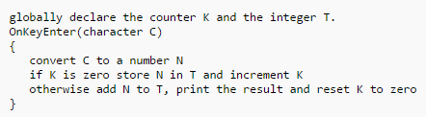
What Event-driven Programming
It is a programming paradigm（范式） in which the flow of the program is determined by events such as user actions or messages from other programs/threads
It is widely applied in the development of JavaScript web applications that are centered on performing certain actions in response to user input.
A event handler
Beijing Jiao Tong University

Slide 5
What Non-blocking I/O
In JavaScript, almost all I/O is non-blocking (Async≠Concurrency). This includes HTTP requests, database operations and disk reads and writes
The single thread of execution asks the runtime to perform an operation, providing a callback function
Then moves on to do something else in sequence.
When the operation has been completed, a message is enqueued along with the provided callback function.
At some point in the future, the message is dequeued and the callback fired.
Beijing Jiao Tong University

Slide 6
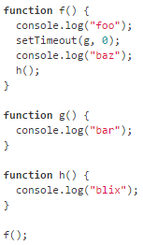
Queuing Additional Messages
Due to the non-blocking nature of setTimeout, its callback will fire at least 0 milliseconds in the future and is not processed as part of this message.
In this example, setTimeout is invoked, passing a callback function g and a timeout of 0 milliseconds. When the specified time elapses (in this case, almost instantly) a separate message will be enqueued containing g as its callback function.
The resulting console activity would look like: “foo”, “baz”, “blix” and then on the next tick of the event loop: “bar”.
Note: If in the same call frame two calls are made to setTimeout – passing the same value for a second argument – their callbacks will be queued in the order of invocation.
Beijing Jiao Tong University

Slide 7
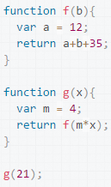
What Frame
When calling g, a first frame is created
containing g arguments and local variables.
When g calls f, a second frame is created and
pushed on top of the first one containing f
arguments and local variables.
When f returns, the top frame element is
popped out of the stack (leaving only g call
frame). When g returns, the stack is empty.
Beijing Jiao Tong University

Slide 8
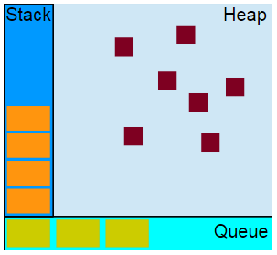
Runtime Concepts
Stack
Function calls form a stack of frames.
Heap
Objects are allocated in a heap which is just a name to denote a large mostly unstructured region of memory.
Queue
A JavaScript runtime contains a message queue, which is a list of messages to be processed.
To each message is associated a function.
When the stack is empty, a message is taken out of the queue and processed.
The processing consists of calling the associated function (and thus creating an initial stack frame).
The message processing ends when the stack becomes empty again.
Beijing Jiao Tong University

Slide 9
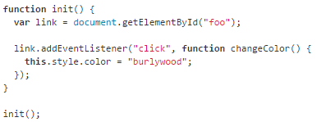
The Event Loop
In a loop, the queue is polled for the next message (each poll referred to as a “tick”) and when a message is encountered, the callback for that message is executed.
The calling of this callback function serves as the initial frame in the call stack. Due to JavaScript being single-threaded, further message polling and processing is halted pending the return of all calls on the stack.
Beijing Jiao Tong University

Slide 10
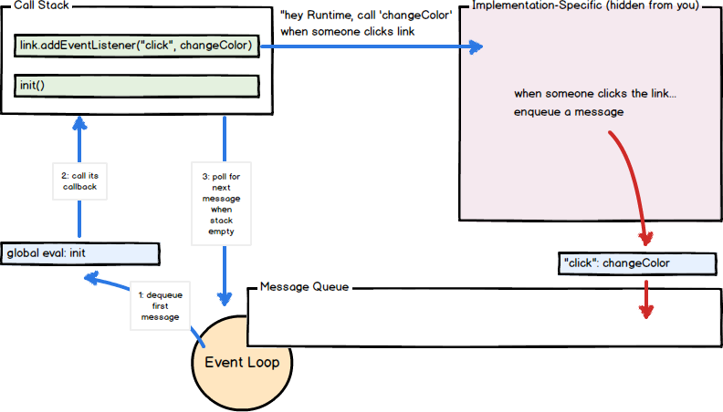
JavaScript Processing Model
Beijing Jiao Tong University

Slide 11
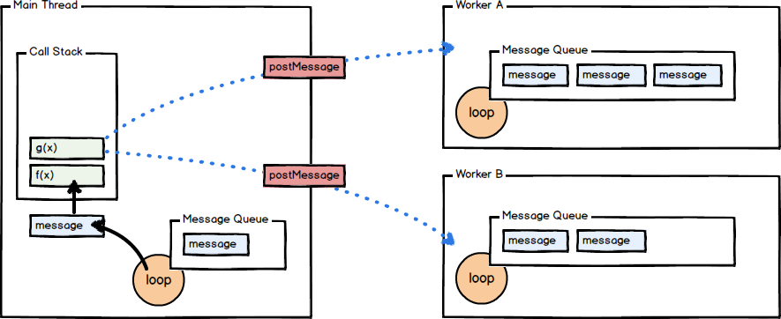
Worker Thread – Web Workers
To offload an expensive operation to a separate thread of
execution, freeing up the main thread to do other things.
The worker includes a separate message queue, event
loop, and memory space independent from the original thread that instantiated it.
Communication between the worker and the main thread is done via message passing.
Beijing Jiao Tong University

Slide 12
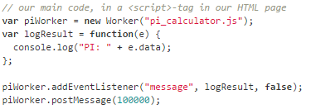
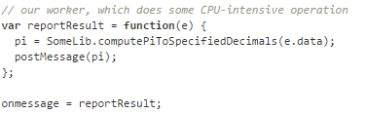
Example for Web Workers
Beijing Jiao Tong University

Slide 13
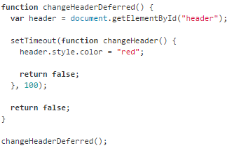
A Note on Closures of JavaScript
Our callbacks are called as part of a different message than the one in which they were created.
changeHeaderDeferred function returns false, ending the processing of the first message, but the header variable is still referenced via a closure and is not garbage collected. Once the second message (the changeHeader function) is processed, the header variable can be garbage collected.
Note: JavaScript’s support for closures allow you to register callbacks that, when executed, maintain access to the environment in which they were created even though the execution of the callback creates a new call stack entirely.
Beijing Jiao Tong University

Slide 14
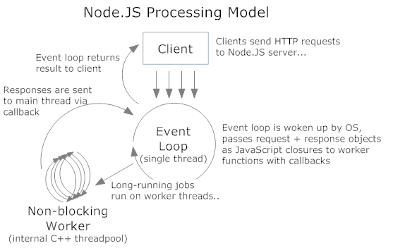
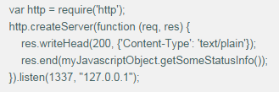
Node.js Concurrent Processing Model
Node’s true innovation is its evented + asynchronous I/O model.
The primary method of any Node application runs a single-threaded continuous event loop (the .listen method of the HTTP server), which farms out long-running tasks to worker threads (the anonymous function) which callback the main event loop once they’re finished:
Beijing Jiao Tong University

Slide 15
Takeaways for Node.js
The main event loop uses a single thread to handle multiple concurrent connections
All long-running tasks (network I/O, data access, etc…) are always executed asynchronously on top of worker threads which return the results via callback to the event loop thread
JavaScript’s language features (functions as objects, closures, etc…) and Node’s programming model make this type of asynchronous / concurrent programming much easier to utilize
-- There’s no thread management, no synchronization mechanisms, and no message-passing nonsense.
Beijing Jiao Tong University

Slide 16
Get started with Node.js
Beijing Jiao Tong University

Slide 17
Web Server powered by Node.js
var http = require('http');
http.createServer(function (req, res) {
res.writeHead(200, {'Content-Type': 'text/plain'});
res.end('Hello World\n');
}).listen(1337, '127.0.0.1');
console.log('Server running at http://127.0.0.1:1337/');
Run the server, execute it with the node program from CLI
% node example.js
Server running at http://127.0.0.1:1337/
Beijing Jiao Tong University

Slide 18
A Typical Example from nodebeginner.org
A Web Server can response to 3 types of requests
-- Start: generate HTML page for user to upload .png file
-- Upload: upload the file to the server (non-blocking)
-- Show: show up the file to the user (non-blocking)
To reach the service in web server
-- http://localhost:8888/start
-- http://localhost:8888/upload
-- http://localhost:8888/show
Server
Start
Index
Router
Upload
Show
Beijing Jiao Tong University

Slide 19
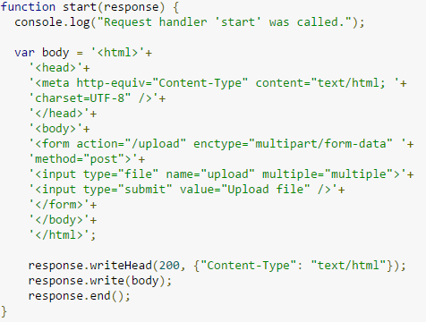
requestHandlers.js – Func@start
Beijing Jiao Tong University

Slide 20
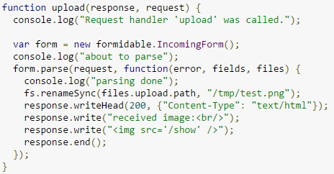
requestHandlers.js – Func@upload
Beijing Jiao Tong University

Slide 21
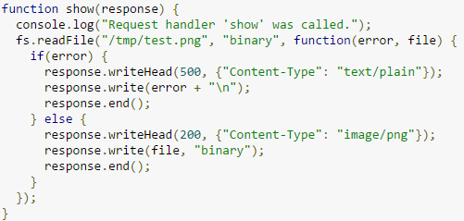
requestHandlers.js – Func@show
Beijing Jiao Tong University

Slide 22
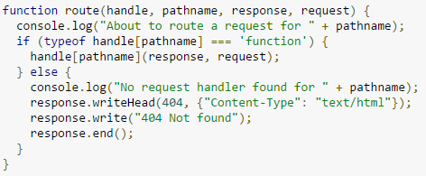
router.js – Func@route
Beijing Jiao Tong University

Slide 23
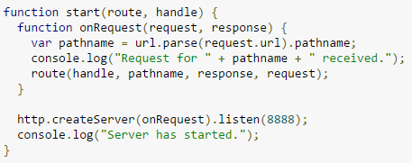
server.js – Func@start
Beijing Jiao Tong University

Slide 24
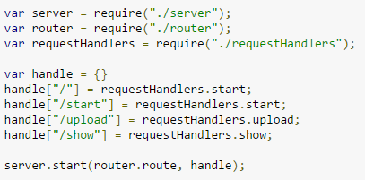
index.js – Entry of the program
Beijing Jiao Tong University

Slide 25
Get started with Express
Beijing Jiao Tong University

Slide 26
Express vs. Express app
Express is a minimal and flexible Node.js web application framework that provides a robust set of features for web and mobile applications.
An Express app is essentially a stack of middleware（中间件） which are executed serially（串联）.
Beijing Jiao Tong University

Slide 27
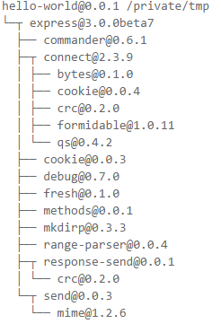
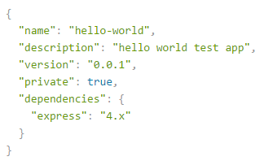
HelloWorld – package.json
Beijing Jiao Tong University

Slide 28



HelloWorld – app.js
Beijing Jiao Tong University

Slide 29
What Middleware
A middleware is a function with access to the request object (req), the response object (res), and the next middleware in line in the request-response cycle of an Express app.
Middleware(s) are execute serially, their order of inclusion is important.
If the current middleware is not ending the request-response cycle, it is important to call next() to pass on the control to the next middleware, else the request will be left hanging.
Beijing Jiao Tong University

Slide 30
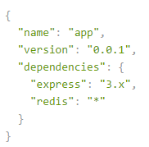
Users Online Count – package.json
Beijing Jiao Tong University

Slide 31
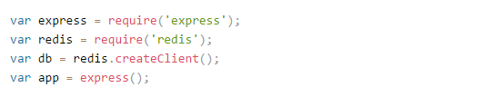
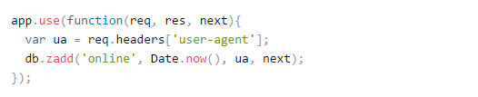
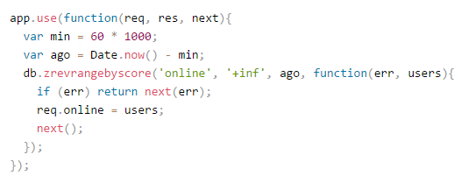
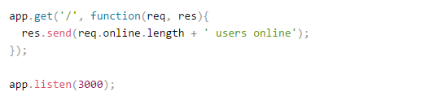
Users Online Count – app.js
reverse lexicographical order
Max: positive infinite
Min: 1 minute ago
Beijing Jiao Tong University

Slide 32
What Router
A router is an isolated instance of middleware and routes.
Routers can be thought of as "mini" applications, capable only of performing middleware and routing functions.
Every express application has a built-in app router.
Routers behave like middleware themselves and can be ".use()'d" by the app or in other routers.
Beijing Jiao Tong University

Slide 33
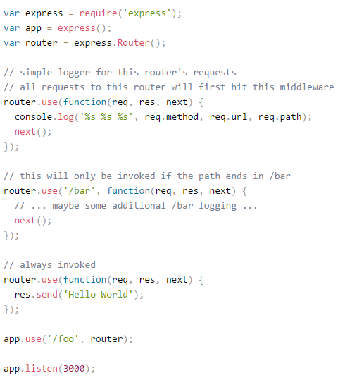
Example for Router
Built-in app router
be ".use()'d" by the app
Beijing Jiao Tong University

Slide 34
Express vs. AngularJS
AngularJS is a beautiful client-side framework, highly testable, that combines tons of cool stuff such as MVC, dependency injection, data binding and much more.
We can use AngularJS for defining your client-side behavior[Views and Controllers] and then write up the REST-Services which AngularJS client can interact with.
The client runs on the web browser[AngularJS], and does asynchronous communication to the server. The server[ExpressJS] then retrieves and stores data for the client.
Beijing Jiao Tong University

Slide 35
Reference
http://blog.carbonfive.com/2013/10/27/the-javascript-event-loop-explained/
http://www.nodejs.org/documentation/
http://www.nodebeginner.org/
http://stackoverflow.com/questions/18817630/what-are-the-basic-differences-and-similarities-between-angular-js-and-express-j
Beijing Jiao Tong University

